Slide 1
Distributed Control and Automation Framework (DCAF)
7 Key points to use Source Code Control In LV

Slide 2
Agenda
Use source control
Remove Source from VI
Don’t Merge
Modular and Organized Code
Communication with the Team
Standard source Code Flow
Use continues integration
Notes:
You should use source control contains the why and how (providers and host
Remove source control just covers why this feature makes it possible
Talk about modularity and file structure
Standard Code Flow (Gitflow and GitFlow light)

Slide 3
1) Use Source Control

Slide 4
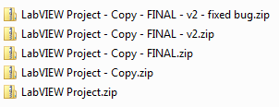
Source Code Control – Do I Need It?
Do I ever make a mistake?
Do my colleagues?
Test More
No
No
Yes
Yes
YES
BAD!
Notes:
Some of you may not be sold, so I offer you this handy flow chart to determine if your project can benefit from source code control.
We’ve all been there at some point, “branching” our code and saving copies by renaming zip files; we’ve all experienced the frustration and potential for accidently modifying the wrong files when using this method. Overall, we should all recognize that it’s very very bad.
For more details on source code control in LabVIEW, please see Eli Kerry’s Software Engineering Technical Manual and Exercises for LabVIEW: https://decibel.ni.com/content/docs/DOC-10122

Slide 5
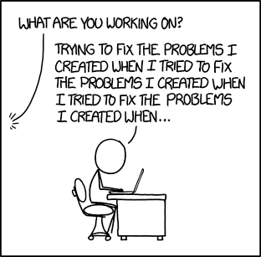
Working Alone
Source: https://xkcd.com/1739/

Slide 6





Hosting
Free options available
Public and private cloud repos
Onsite instance usually $$$
Integrated issue tracking, release management, and code versioning
Continuous Integration possible with LabVIEW
….and many more
Notes:
The two major players in the hosting space for open source projects are GitHub and Bitbucket. GitHub alone hosts over 38 million projects and has 15 million users. In my experience, GitHub is the best host for Git projects using open-source tooling, Bitbucket is the best host if you’re using Mercurial (though it does also work with Git) or if you’re already using Atlassian’s suite of products (Bitbucket is owned and operated by Atlassian, so it integrates well with their other services).
There are other, more niche, players in the space, and new ones pop up every few months (Gitlab, for example, is popular with some developers I’ve worked with). If you’re not sure where to start, GitHub is a solid default option, since it has the largest user base.

Slide 7
2) Remove Source From VI

Slide 8
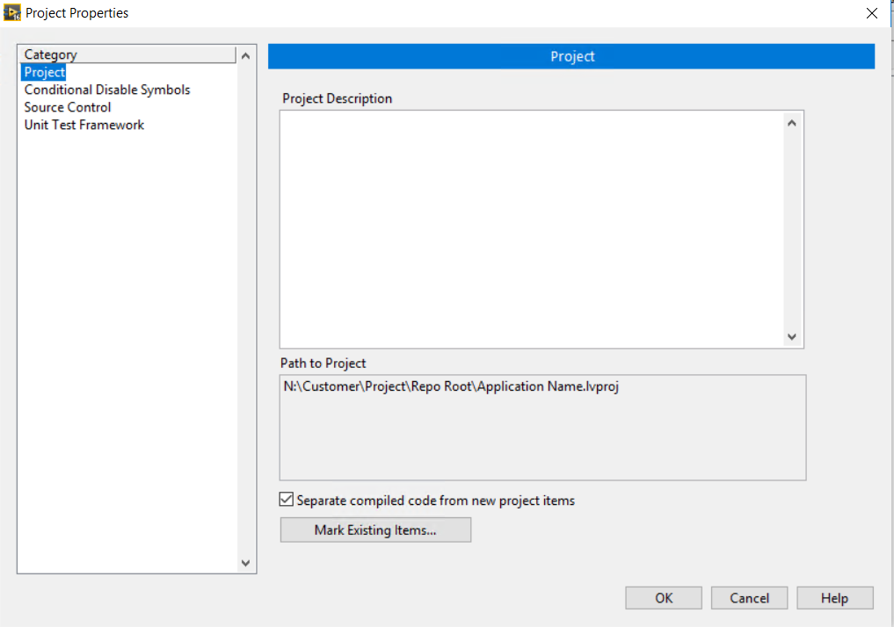
Separate compiled code
Separate source code from compiled files
Reduces “phantom” changes
Set this on the project level so you don’t forget
Remember: Don’t deliver source code without an export

Slide 9
3) Don’t Merge

Slide 10

Merge Battles
Ideally, we want to prevent this:
…but how?

Slide 11
Merge Battles
Merge battles are caused by multiple, simultaneous, and conflicting changes to the same files from multiple users or branches
Merging graphical files is possible, but not fun
Avoiding, or at least simplifying, merge conflicts is the way to stay (mostly) sane

Slide 12
Merge Battles
Merge battles are caused by multiple, simultaneous, and conflicting changes to the same files from multiple users or branches
Merging graphical files is possible, but not fun
Avoiding, or at least simplifying, merge conflicts is the way to stay (mostly) sane

Slide 13
4) Project Organization and Modular Code

Slide 14
LV Project Organization - Bad
Monolith
Random VIs scattered across disk locations
Crosslinked code that has surprising external dependencies
Code that you forgot depends on driver A, B, and C, a modified example you downloaded from ni.com, and three old VI Packages you downloaded but forgot about
“Reuse library” consisting of all of the old code from all projects you’ve done over the past decade copy and pasted into every new project directory

Slide 15
LV Project Organization - Bad
Monolith
Random VIs scattered across disk locations
Crosslinked code that has surprising external dependencies
Code that you forgot depends on driver A, B, and C, a modified example you downloaded from ni.com, and three old VI Packages you downloaded but forgot about
“Reuse library” consisting of all of the old code from all projects you’ve done over the past decade copy and pasted into every new project directory

Slide 16
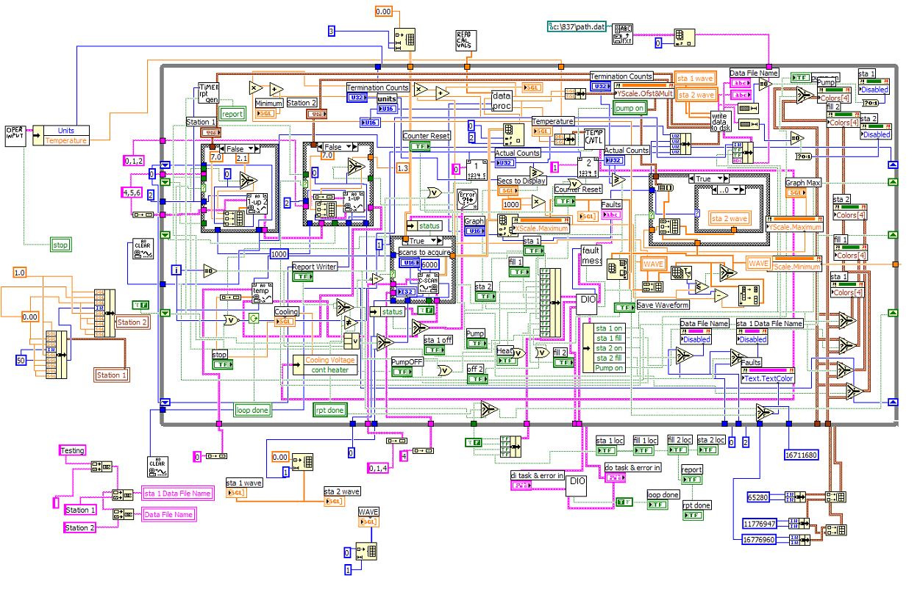
LabVIEW Code Structure - Bad
No monoliths!

Slide 17
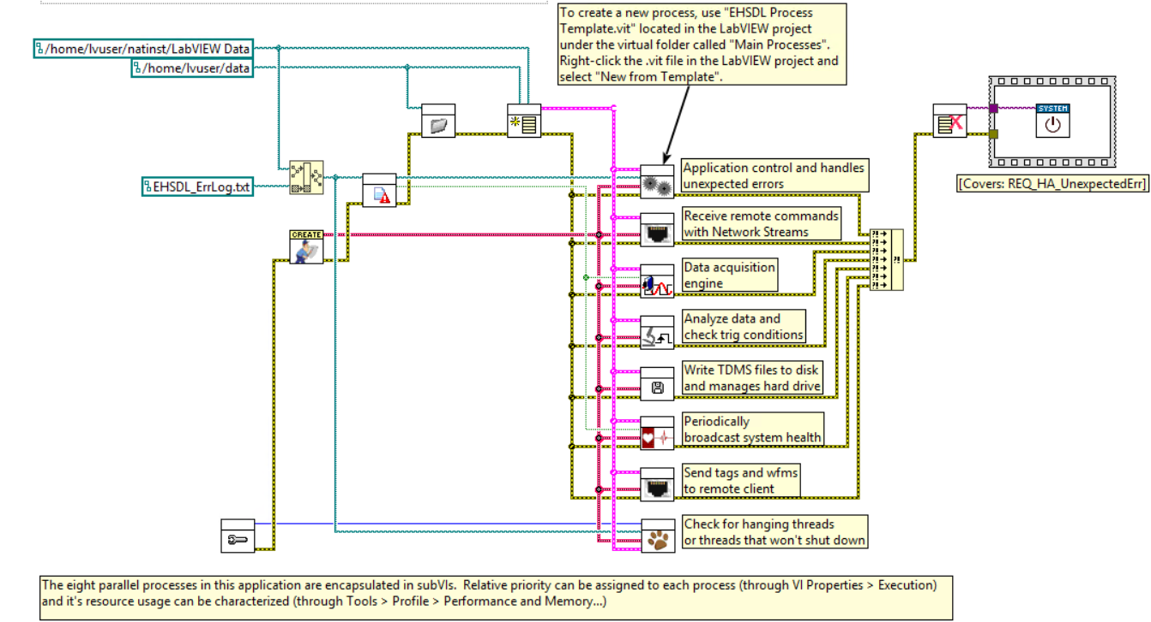
LabVIEW Code Structure - Good
Multiple layers of code, clearly separated
Encapsulation permits simultaneous development
Notes:
Ask yourself – what parts of the codebase can be changed without breaking my code? What parts can be changed without affecting my ability to test my code?

Slide 18
LabVIEW Code Structure – LVOOP
LVOOP is great for splitting code into small pieces
BUT reorganization of all those files can be painful in source control
Give yourself two versions to throw away
Remember: Commit the .lvproj, .lvlib, and .lvclass files as well as VIs!

Slide 19
5) Communication with the Team

Slide 20
Communicate
Developers should know what to work on
Duplicate efforts are a common cause of conflicts
Need a collaboration tool
Work backlog
Task assignments
Linked to code!
No, the answer is not an excel doc on the network share

Slide 21
GitHub Issues
Create Issues in GitHub
Assign Issues

Slide 22
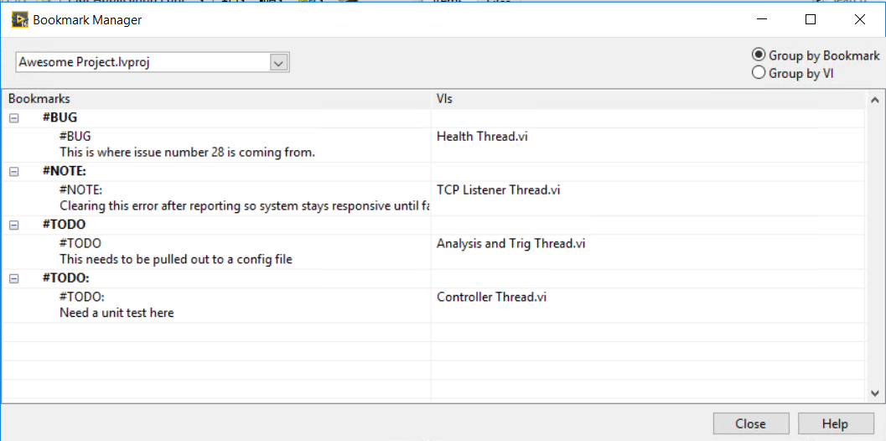
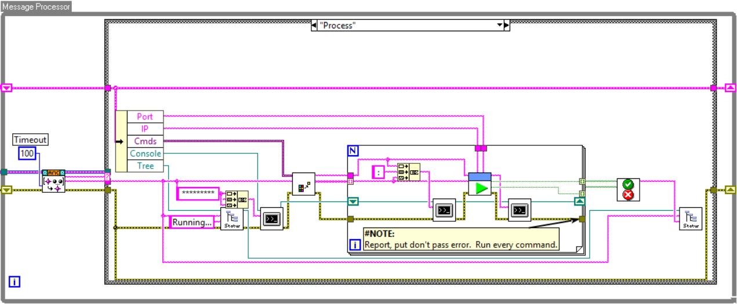
Communication with Code
Leverage LabVIEW Bookmarks
Include comments in the code anywhere style was violated

Slide 23
Communication With Code
Include useful commit comments in source control
Keep commits small and atomic
Link features/bug fixes to your commits

Slide 24
6) Standard Flow

Slide 25





Developer Workflow
!
✓

Slide 26
Developer Workflow
!
✓
All work is done to resolve one or more issues
Issues must be defined and assigned before working on the issue

Slide 27
Developer Workflow
!
✓
Developer creates a new branch from master
Issue(s) moved to In Work state in project
All work happens in a branch, never in master
Branches are short-lived

Slide 28
Developer Workflow
!
✓
Developer makes frequent commits to their branch
Continuous Integration server builds and tests each commit
Master branch remains untouched

Slide 29
Developer Workflow
!
✓
Once ready for review, developer makes a pull request
Moved to ‘Pending Review’ state in project
CI server validates branch:
Builds without error
Passes all unit tests
Passes all integration tests

Slide 30
Developer Workflow
!
✓
Pull requests must be reviewed by at least one other contributor
Reviewer validates that all issues are resolved
Reviewer may request changes or clarifications from developer

Slide 31
Developer Workflow
!
✓
Pull request can be merged into master if and only if:
Passes all tests and builds with no errors
Has been approved by at least one other contributor
Has all merge conflicts with master resolved

Slide 32
Developer Workflow
!
✓
Once pull request is merged:
Close all addressed issues
Delete issue branch
Mark as Done in project

Slide 33
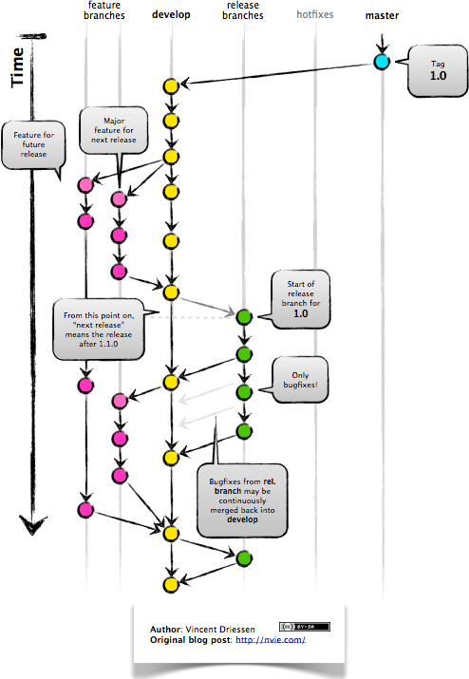
GitFlow
Notes:
https://datasift.github.io/gitflow/IntroducingGitFlow.html

Slide 34
7) Use Continuous integration

Slide 35
Automation - Test
Source control providers include hooks to continuous integration services
Automatically run all build/test operations on every commit
Track unit test results to a particular commit of files
Make sure that you didn’t break it
Require commit to pass all tests before it can be merged
Prevents one developer’s mistake from hurting everyone
Don’t be that guy

Slide 36
Unit Testing
Add the summary slide from the Unit Test Chapter

Slide 37
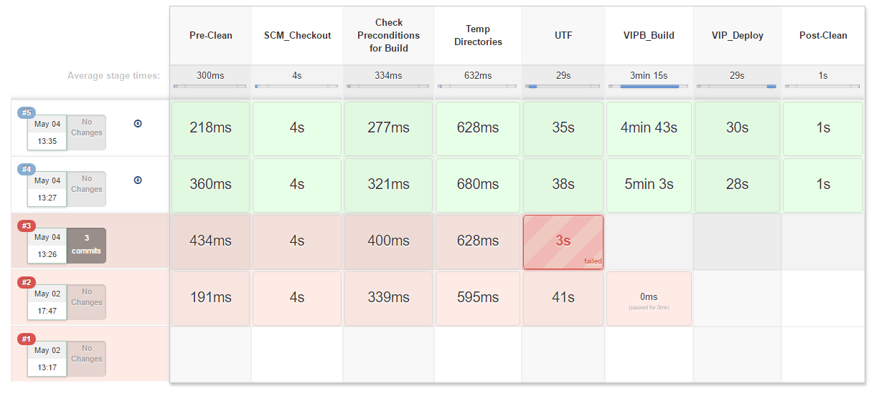
Automation - Pipelines
One job, many stages
Build process as code
Can reuse same pipeline across many projects
Can extend with shared libraries
Build VI Package, Run UTF Tests, etc.
Each method is exposed as a simple pipeline step
Can make command line calls
Notes:
Jenkins can use the pipeline plugin to do awesome things that previously required many linked jobs
Build process as code
Jenkins runs simple Pipeline job that calls a script file
Jenkinsfile
Jenkinsfile invokes various pipeline commands to string together a set of actions that constitute the build pipeline
Pipeline scripts can be reused across many jobs
Pipeline scripts are in source code control
Pipeline repo can be shared across multiple projects and jobs
Pipeline scripts are extensible with custom scripting actions

Slide 38
Last Link in a Continuous Delivery Chain
Publish to SFTP
Checkout source code
Unit Test
Build
Publish to Unstable
Integration Test
Manual Check
Publish to Box
Publish to GitHub
…

Slide 39
Conclusions
Use source control
Remove Source from VI
Don’t Merge
Modular and Organized Code
Communication with the Team
Standard source Code Flow
Use continues integration

